Slide 1



Software Engineering for Data Scientists
Knowledge and solutions for a changing world
Advancing data-intensive discovery in all fields
Be boundless
Reproducible computations
David A. C. Beck (dacb)
Chemical Engineering & eScience Institute

Slide 2
Overview
Terminology
What are we guarding against?
What are the tools we can use for defense?

Slide 3
Terminology
Reviewable research
The descriptions of the research methods can be independently assessed and the results judged credible.
Replicable research
Tools are made available that would allow one to duplicate the results of the research.
Confirmable research
The main conclusions of the research can be attained independently without the use of software provided by the author.

Slide 4
Terminology
Auditable research
The main conclusions of the research can be attained independently without the use of software provided by the author.
Reproducible research
Well-documented and code and data that are available that would allow one to (a) fully audit the computational procedure, (b) replicate and also independently reproduce the results of the research, and (c) extend the results or apply the method to new problems.

Slide 5
Reproducibility
Can an experimental result be reproduced?
Reproducibility comes in different flavors
Same data, same analyses (Reproducible)
Similar data, same analyses (Replicability)
Same data, similar analyses (Robustness)
Others?
Today I’ll use Reproducibility to cover all of these

Slide 6
Epic fail Schadenfreude parade*
*a feeling of joy that comes from seeing or hearing about another person's troubles or failures. – Wikipedia
I share this with you so you can be an advocate for these ideas in your team.

Slide 7
Epic fail
In 2011, Bayer (pharmaceuticals) tried to replicate 67 important papers
Oncology
Women’s health
Cardiovascular medicine
Only about 21% were reproducible
Begley, C. G.; Ellis, L. M. (2012). "Drug development: Raise standards for preclinical cancer research". Nature 483 (7391): 531–533.

Slide 8
Epic fail, part 2
In 2012, Amgen published a report in Nature
Examined 53 landmark studies in cancer
6 of 53 (11%) were reproducible
Begley, C. G.; Ellis, L. M. (2012). "Drug development: Raise standards for preclinical cancer research". Nature 483 (7391): 531–533.

Slide 9
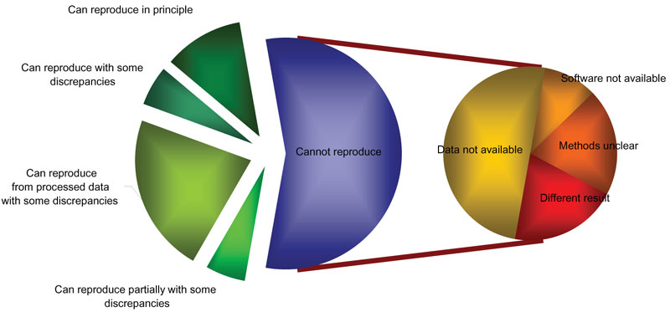
Epic fail, part 3
Attempt to reproduce 18 tables and figures papers published in Nature Genetics using microarrays
Ionnidis, P. et al. Repeatability of published microarray gene expression analyses. Nat Gen , 41:2, Feb 2009

Slide 10
Epic fails in medicine
What are the repercussions of irreproducible results in medicine?
Biotech companies
Government
People?
Notes:
Billions of wasted spending, ineffective drugs brought to market, dangerous drugs brought to market, worst of all: death!10-15 years, 500m

Slide 11
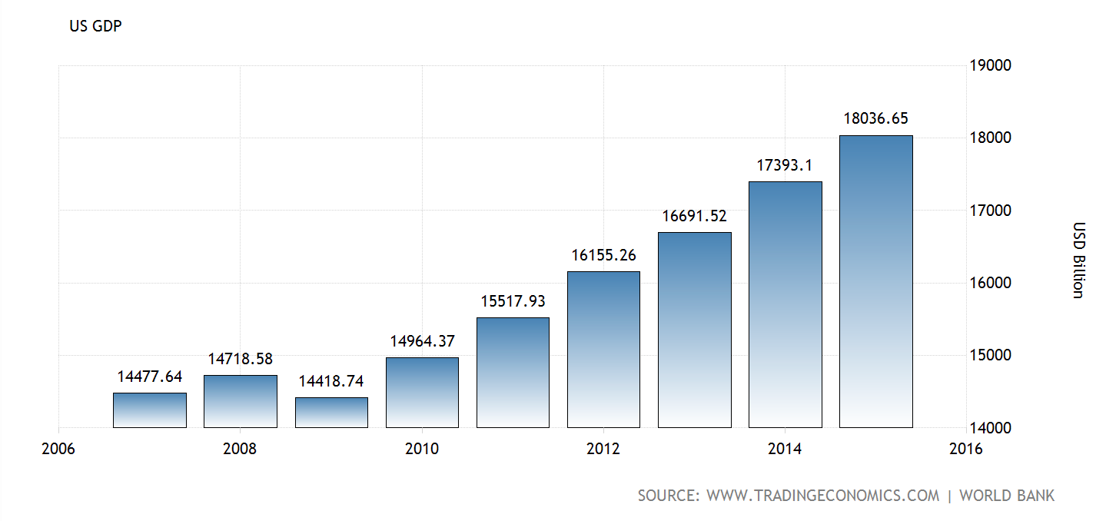
Epic fail, global impact
Grab your way-back hat and put it on!

Slide 12
Epic fail, global impact
Grab your way-back hat and put it on!

Slide 13
Epic fail, global impact
2010 paper by Reinhart & Rogoff “Growth in a Time of Debt”
…high debt/GDP levels (90 percent and above) are associated with notably lower growth outcomes.
Debt to GDP ratios over 90% have read GDP growth of -0.1%
Seldom do countries “grow” their way out of debts.
Reinhart, Carmen M., and Kenneth S. Rogoff. 2010. "Growth in a Time of Debt." American Economic Review, 100(2): 573-78.

Slide 14
Epic fail, global impact
Paper was widely cited by
Political parties
Governments
International lending agencies
To show that austerity was the solution to the global recession
Even part of the 2012 US presidential election!
Reinhart, Carmen M., and Kenneth S. Rogoff. 2010. "Growth in a Time of Debt." American Economic Review, 100(2): 573-78.

Slide 15
Epic fail, global impact
UMass Amherst Graduate student Thomas Herndon
Tried to reproduce the results of the paper for a class: couldn’t
Requested the ‘code’ for the computations from R&R: got an Excel spreadsheet
Found multiple errors
Reinhart, Carmen M., and Kenneth S. Rogoff. 2010. "Growth in a Time of Debt." American Economic Review, 100(2): 573-78.
Thomas Herndon, Michael Ash & Robert Pollin, Does High Public Debt Consistently Stifle Economic Growth? A Critique of Reinhart and Rogoff

Slide 16
Epic fail, global impact
UMass Amherst Graduate student Thomas Herndon
Found multiple errors
Coding errors, selective exclusion of available data, and unconventional weighting of summary statistics lead to serious errors that inaccurately represent the relationship between public debt and GDP growth.
Reinhart, Carmen M., and Kenneth S. Rogoff. 2010. "Growth in a Time of Debt." American Economic Review, 100(2): 573-78.
Thomas Herndon, Michael Ash & Robert Pollin, Does High Public Debt Consistently Stifle Economic Growth? A Critique of Reinhart and Rogoff

Slide 17
Epic fail, global impact
Herndon fixed the errors and reexamined claims
Original claims
Debt to GDP ratios over 90% have real GDP growth of -0.1%
In a recession: Austerity good, spending bad
Modified claims
Debt to GDP ratios over 90% have real GDP growth of 2.2%
In a recession: Spending good
Reinhart, Carmen M., and Kenneth S. Rogoff. 2010. "Growth in a Time of Debt." American Economic Review, 100(2): 573-78.
Thomas Herndon, Michael Ash & Robert Pollin, Does High Public Debt Consistently Stifle Economic Growth? A Critique of Reinhart and Rogoff

Slide 18
Epic fail, global impact
Grab your way-back hat and put it on!

Slide 19
Epic fail, global impact
What effect did the incorrect R&R paper have?

Slide 20
Epic failure, part 4
http://www.nature.com/news/over-half-of-psychology-studies-fail-reproducibility-test-1.18248

Slide 21
Why is this happening?
Social factors, e.g.
Fraud, misconduct
Pressure to publish
p-hacking
Poor experimental design
Small effect size
Small sample size
Data not available or disclosed
Software not available or other software issue
Important but not Data Science related.
WE ARE WORKING ON THESE!

Slide 22
p-hacking
Do a study to test some hypothesis
E.g. an apple a day keeps the Dr. away
Use a p-value of 0.05
i.e. 5% chance of seeing a difference at least as big as we have, by chance alone
Perform 1000s of statistical tests
What happens?
Some significant results by chance alone
1. Simmons, J.P., N.D. Nelson, and U. Simonsohn. 2011. False-positive psychology: Undisclosed flexibility in data collection and analysis allows presenting anything as significant. Psychological Science 22(11):1359-1366.

Slide 23
Data
Data availability
Deposit data in a repository
Versioning
Explicit versioning in file names
Record date retrieved in file names
Compute and record md5sum of files (demo)
Different data or new data

Slide 24
Data
Why would more data change the result?
Use a p-value of 0.05
i.e. 5% chance of seeing a difference at least as big as we have, by chance alone
Was the effect size small?
Report more than the p-value
Sample size
Effect size

Slide 25
Why is this happening?
Software not available or other software issue
Software or source code private
’Open’ software is reviewable
’Open’ software is replicable
’Open’ software is producible
’Open’ software is auditable
Code reviews for quality, purpose and intent
You learn stuff from reviewing other people’s code
People help you find stuff in your own code
Remember that compliment sandwiches taste great!

Slide 26
Why is this happening?
Software not available or other software issue
Dependency hell
Dependency chains (A depends on B depends on C …)
Conflicting dependencies
Circular dependencies (A depends on B depends on A)

Slide 27
Why is this happening?
Software not available or other software issue
Dependency hell
Virtual environments (for python)
conda create –n <name> <options>
Where options are things like what python version to use
https://conda.io/docs/using/envs.html
After creating, switch to it with ‘source activate <name>’
Do a `which python`
Switch out with ‘source deactivate <name>’
Use conda or pip to install packages
Export environment: `conda env export > environment.yml`
Create an environment: `conda env create -f environment.yml`
List environments: `conda env list`
Play time!

Slide 28
Why is this happening?
Software not available or other software issue
Dependency hell
Virtual environments (for python)
Solves many problems but not all…
Why?

Slide 29
Why is this happening?
Example trace command:
% echo ‘print(“hello world”)’ > test.py
% reprozip trace python test.py
Software not available or other software issue
Dependency hell
Reprozip (http://reprozip.readthedocs.io/en/1.0.x/reprozip.html)
Captures all the necessary components in a single, distributable package
Install: ’pip install reprozip’
Trace:
First time: ’reprozip trace <command line>’
Subsequent: ’reprozip trace --continue <command line>’
Package: ‘reprozip pack package.rpz’
Share the .rpz

Slide 30
Why is this happening?
Software not available or other software issue
Dependency hell
Reprozip
Info: `reprounzip info <package>.rpz`
Unpack the rpz:
Pick a compatible unpacker
`reprounzip <unpacker> setup <package>.rpz <path>`
`reprounzip <unpacker> run <path>`
`reprounzip <unpacker> run <path> --cmdline <new-command-line>`
ALWAYS cleanup with
`reprounzip <unpacker> destroy <path>`

Slide 31
Why is this happening?
Software not available or other software issue
Dependency hell
Reprozip
Variety of unpackers:
Directory – puts everything in a directory, failure prone
Chroot– creates a copy of the OS and ‘changes the root’
Installpkgs – tries to install packages into the OS environment (linux only)
Vagrant – makes a virtual machine (requires Vagrant and Virtual Box)
Docker – makes a docker container (light weight virtual machine)
Play time! (Try the directory unpacker, did it work?)

Slide 32
Why is this happening?
Software not available or other software issue
Dependency hell
Manual creation of a virtual
Virtual Box
Amazon machine image
Docker image

Slide 33
Why is this happening?
Software not available or other software issue
Dependency hell

Slide 34
Why is this happening?
Software not available or other software issue
Software version
Don’t know or can’t remember what version was used
Version control
Use `tags` to label versions
The bad: tags can be moved
Use commit hashes to identify versions
Commit ID cannot be moved
Use Zenodo to get a DOI (GitHub)

Slide 35
Software
Software not available or other software issue
Testing
Unit tests prevent again regression bugs
Use continuous integration
Automatically runs unit tests
Computes coverage
Let’s you know if you broke ‘stuff’

Slide 36
Software
Software not available or other software issue
Lack of documentation

Slide 37
Software
Software not available or other software issue
Lack of documentation
You change postings someone can run your code
Best reason:
A year later you can run your own code!

Slide 38
Software
Software not available or other software issue
Lack of documentation
How to run the code
Dependencies (as you understand hell)
Provide an example notebook
Example dataset

Slide 39
Software
Questions?

